Slide 1
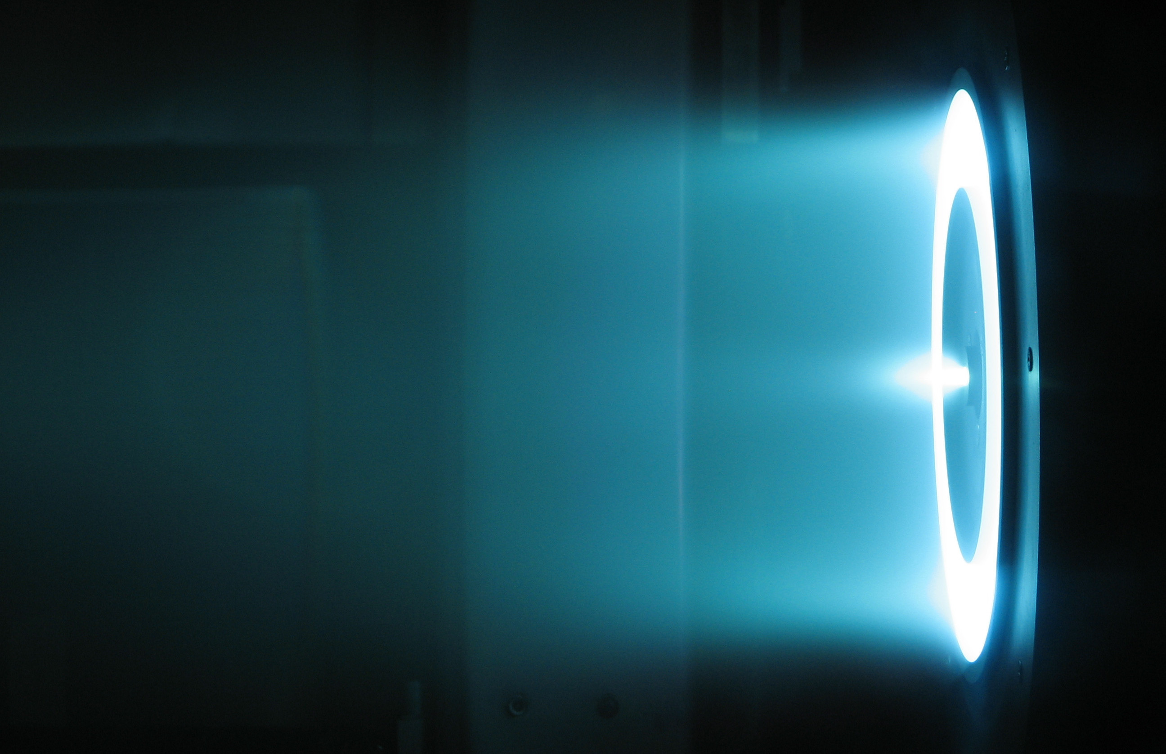
Who Studies Hall Effect Thrusters and Where?
David M Vermillion
Notes:
How they work

Slide 2
Background
Personal Project
Metadata

Slide 3
Locations
Research Centers
Cities
Notes:
Only two responsible centers:
Space Technology Mission Directorate was almost exclusively the responsible center.
Only two mentions were made of the Human Exploration and Operations Mission Directorate

Slide 4
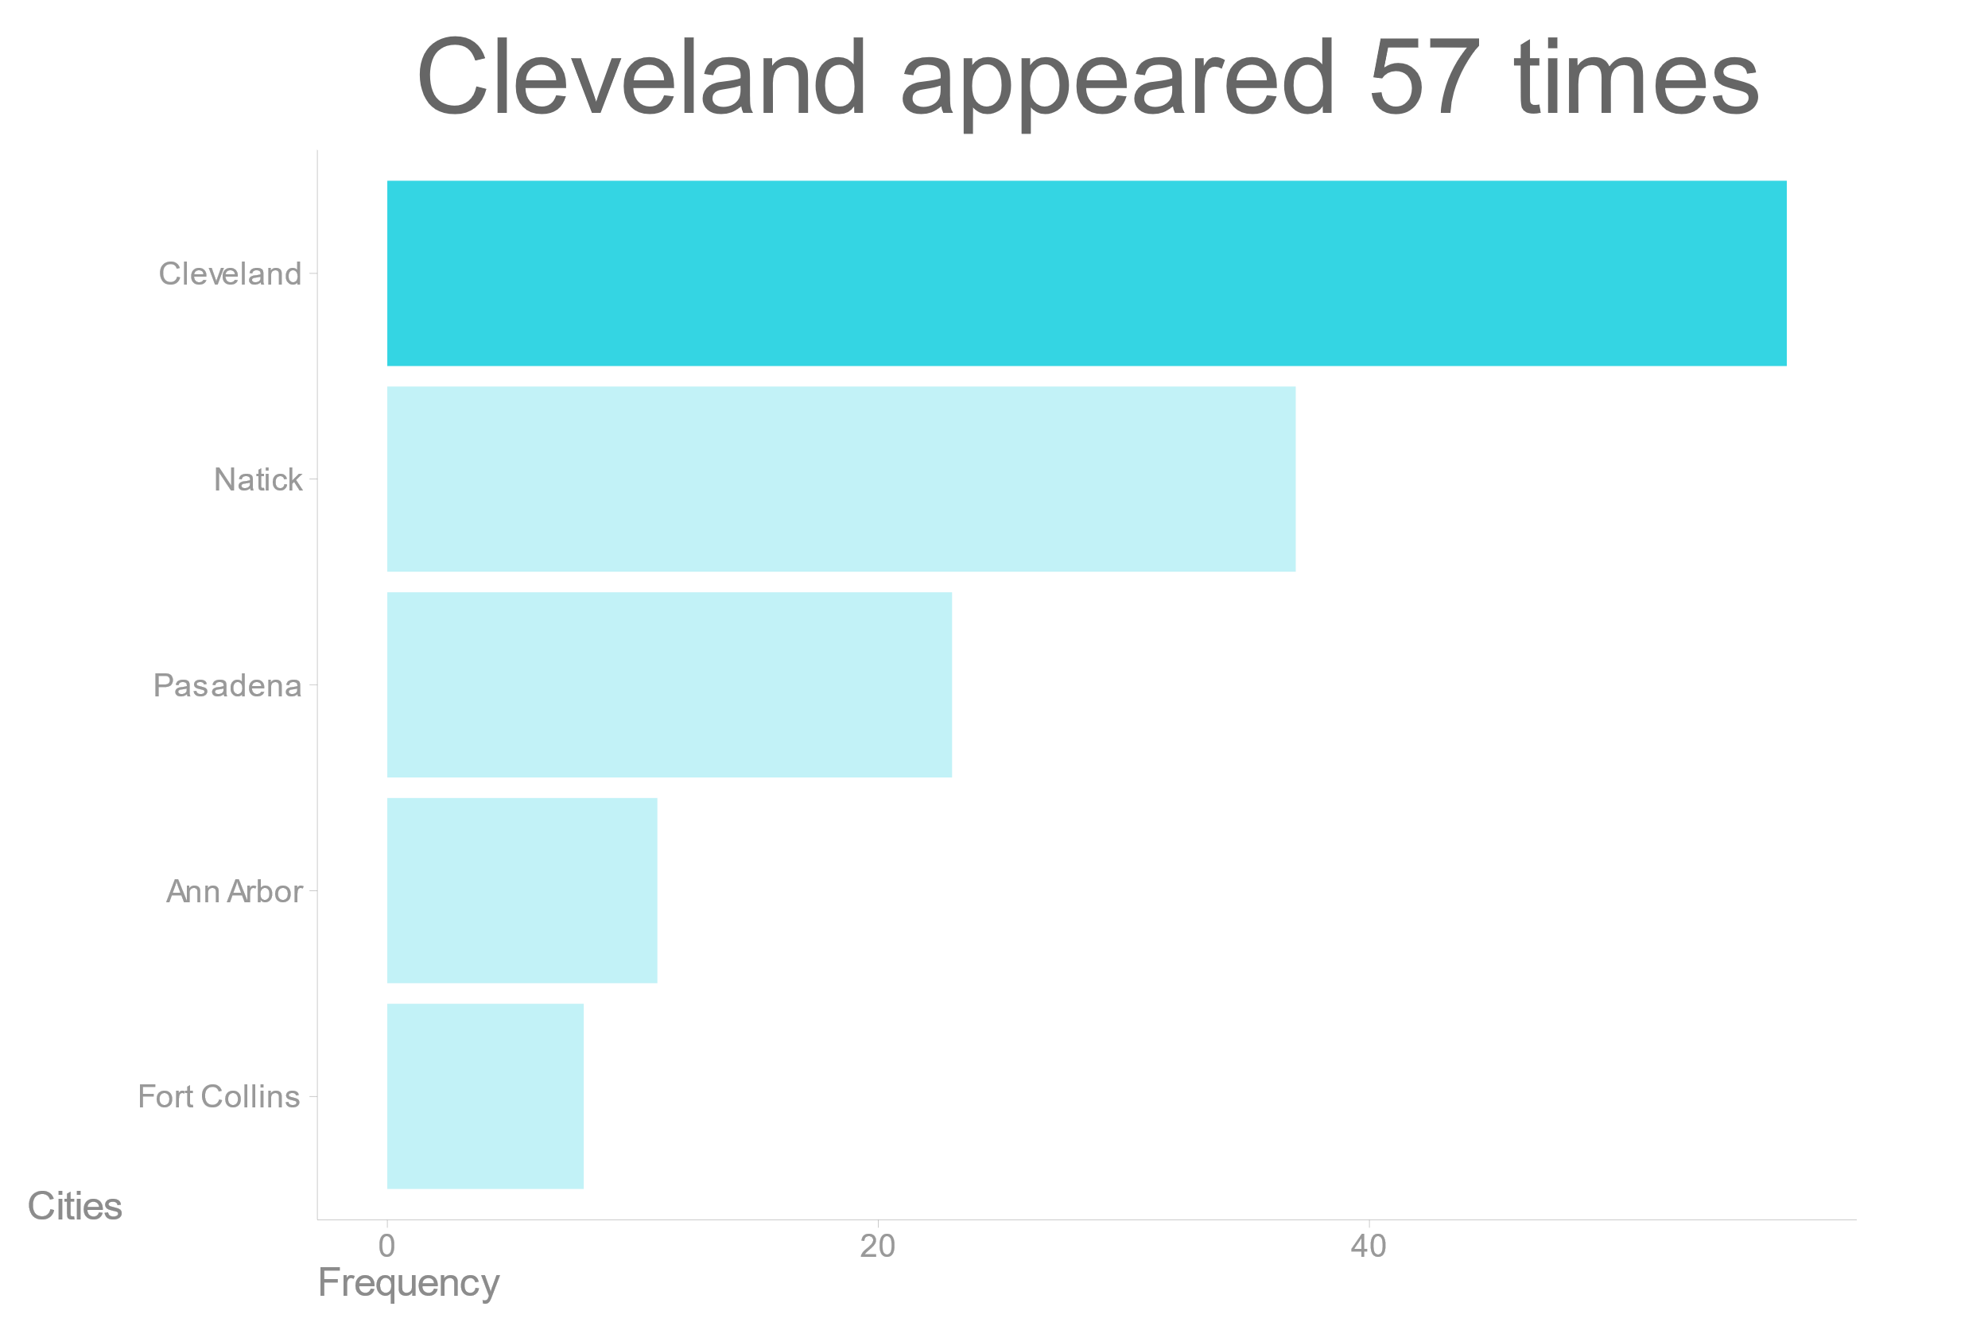
Cleveland appeared 57 times

Slide 5
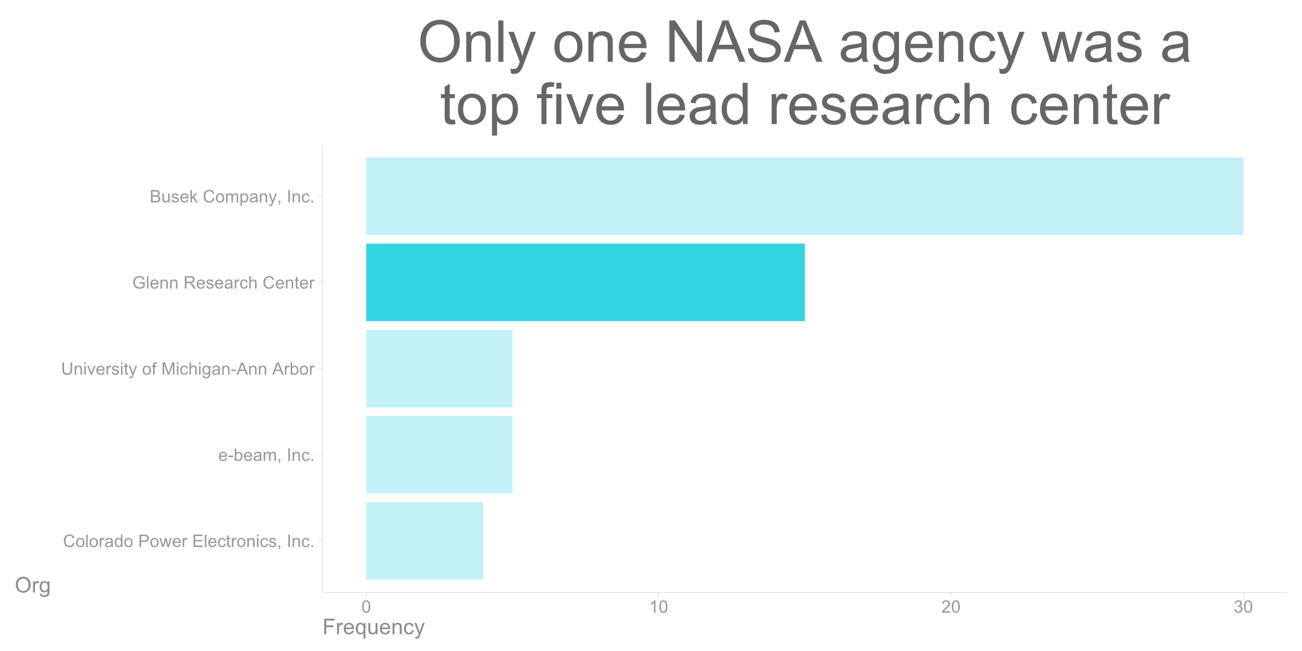
Only one NASA agency was a top five lead research center

Slide 6
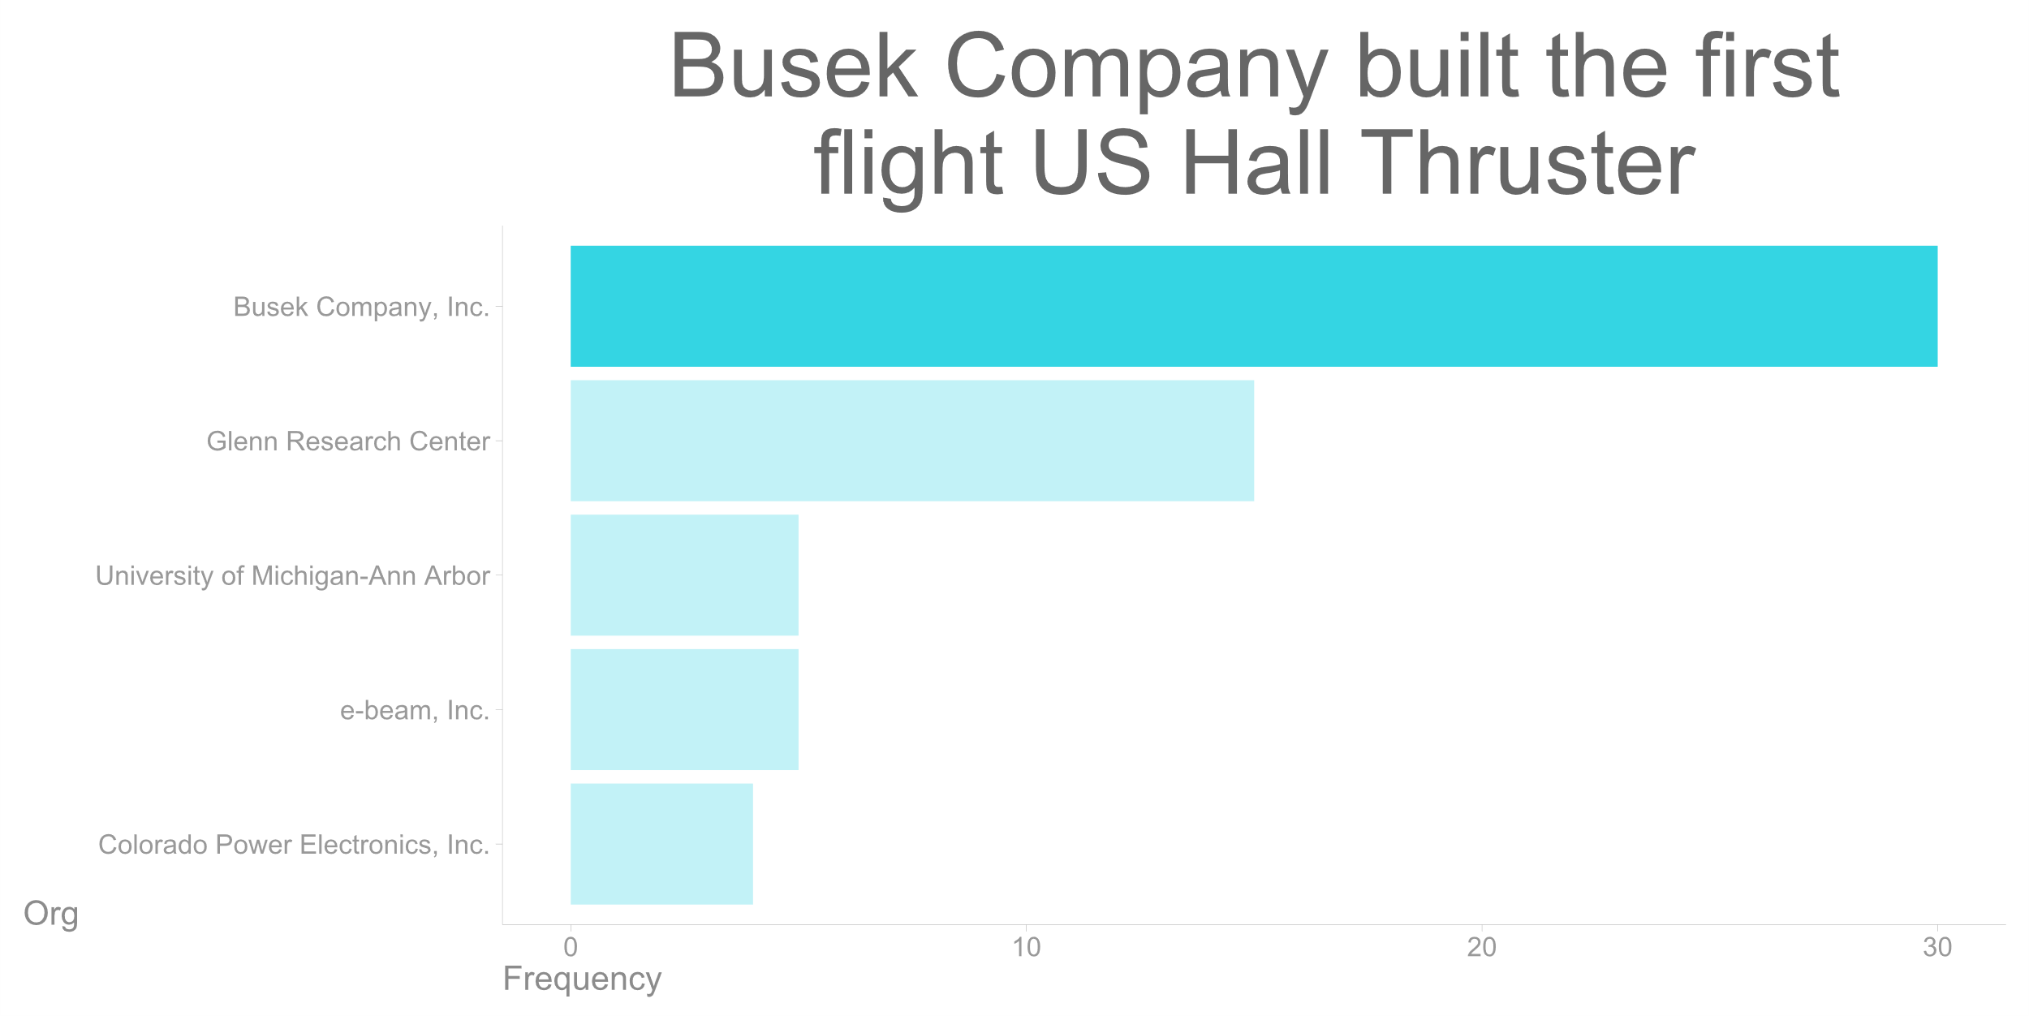
Busek Company built the first flight US Hall Thruster
Notes:
Busek built the first flight US Hall Thruster

Slide 7
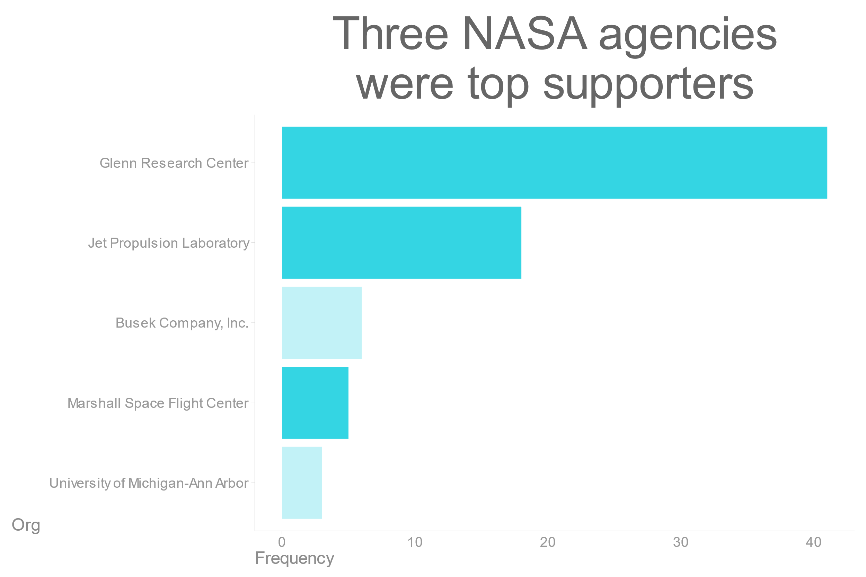
Three NASA agencies were top supporters

Slide 8
Title and Description
Sentiment Analysis
Word Frequency

Slide 9
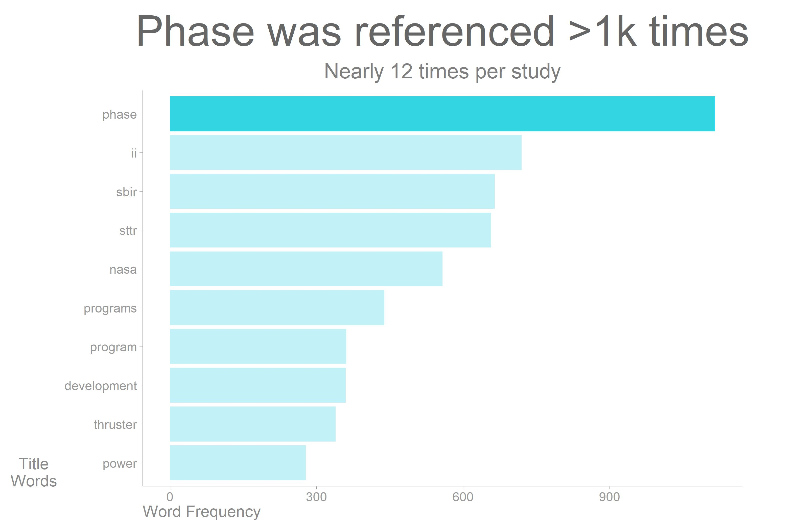
Phase was referenced >1k times
Notes:
NASA Small Business Innovation Research and Small Business Technology Transfer (SBIR/STTR)

Slide 10
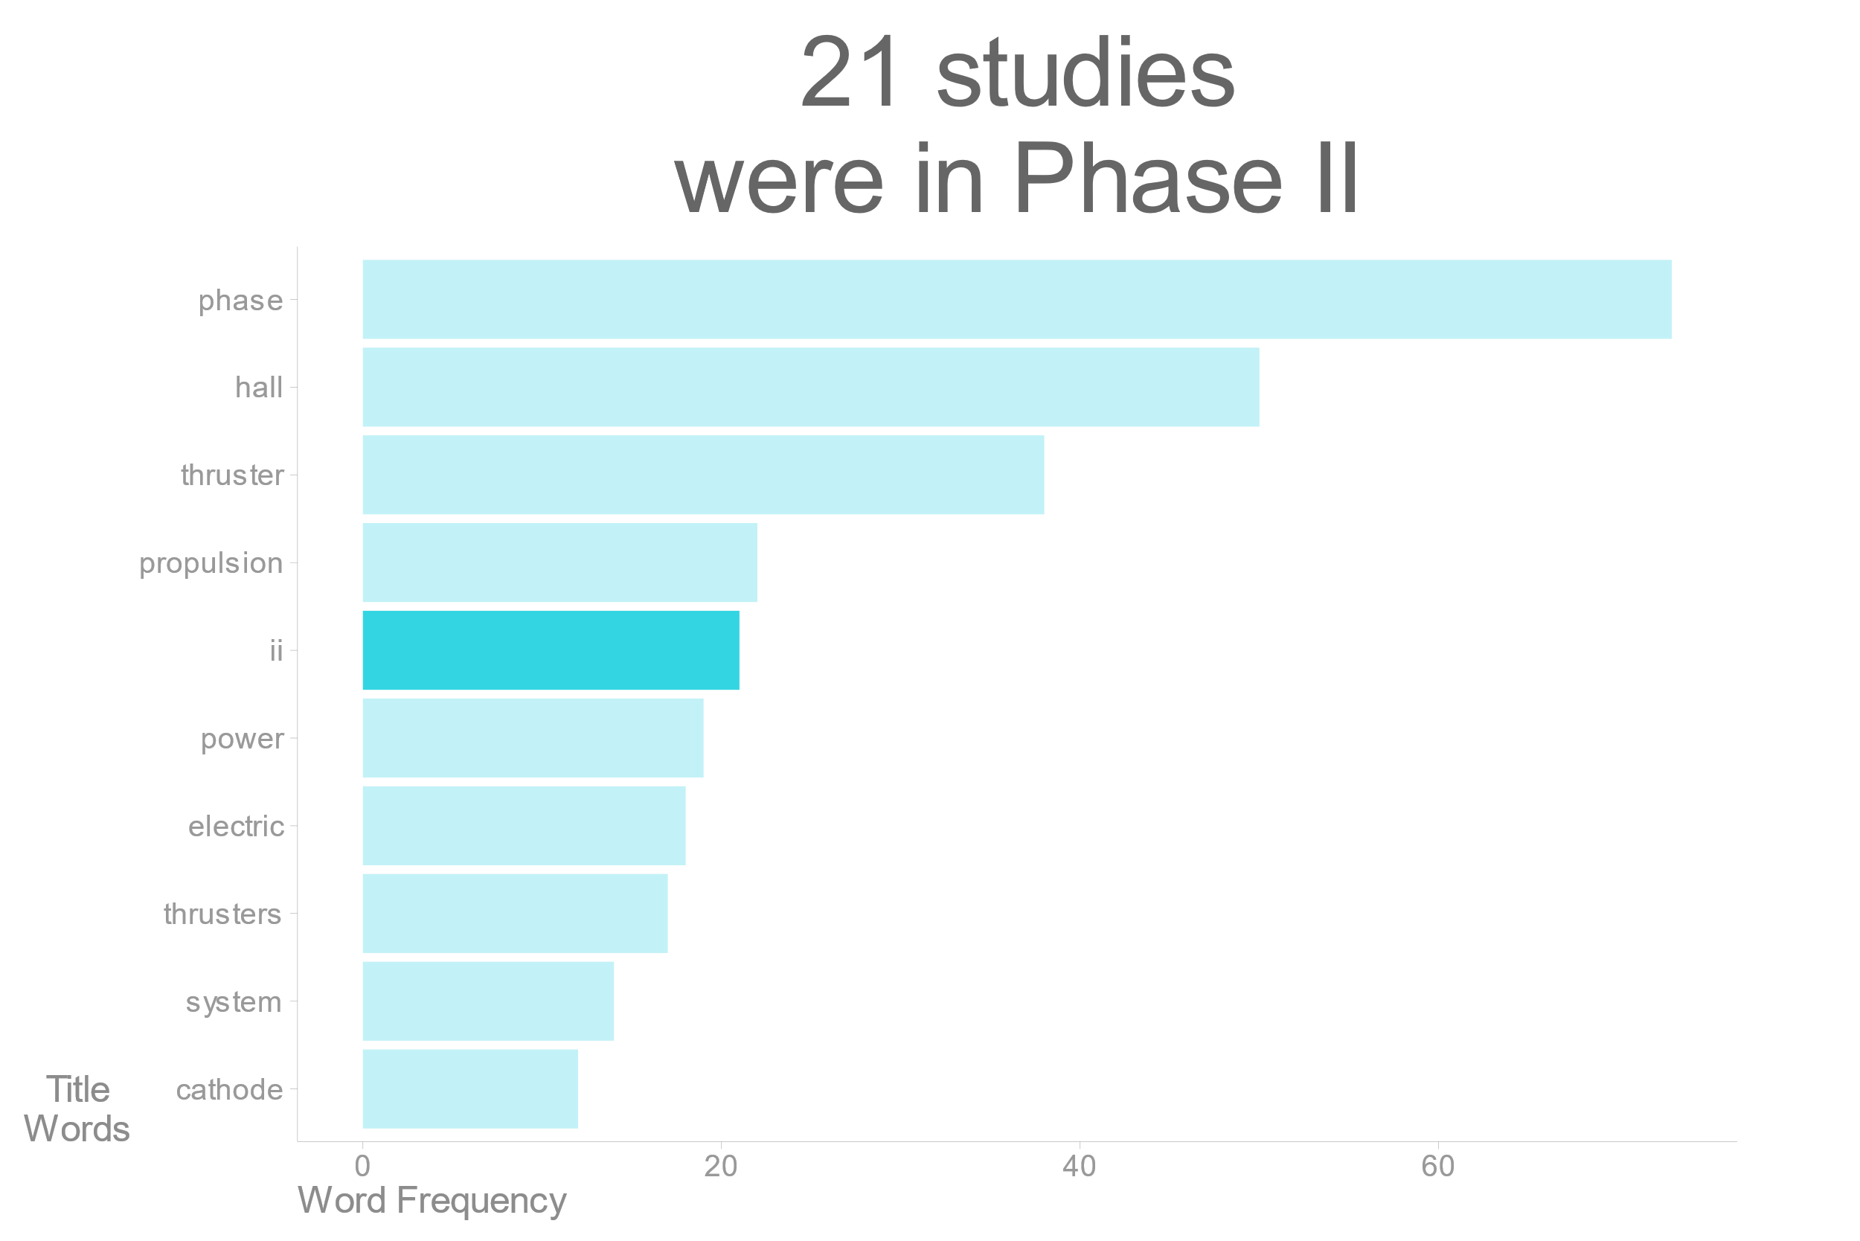
21 studies were in Phase 2
Notes:
Title
22% in phase II

Slide 11
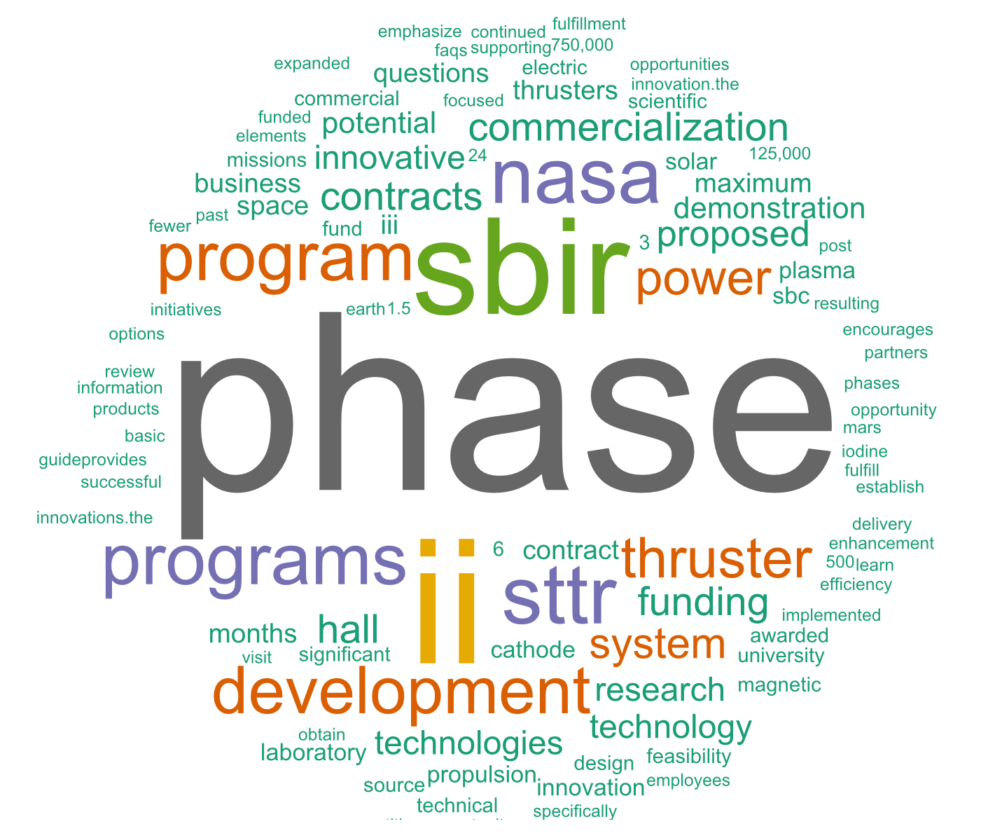
Word cloud for the description fields
Notes:
Description

Slide 12
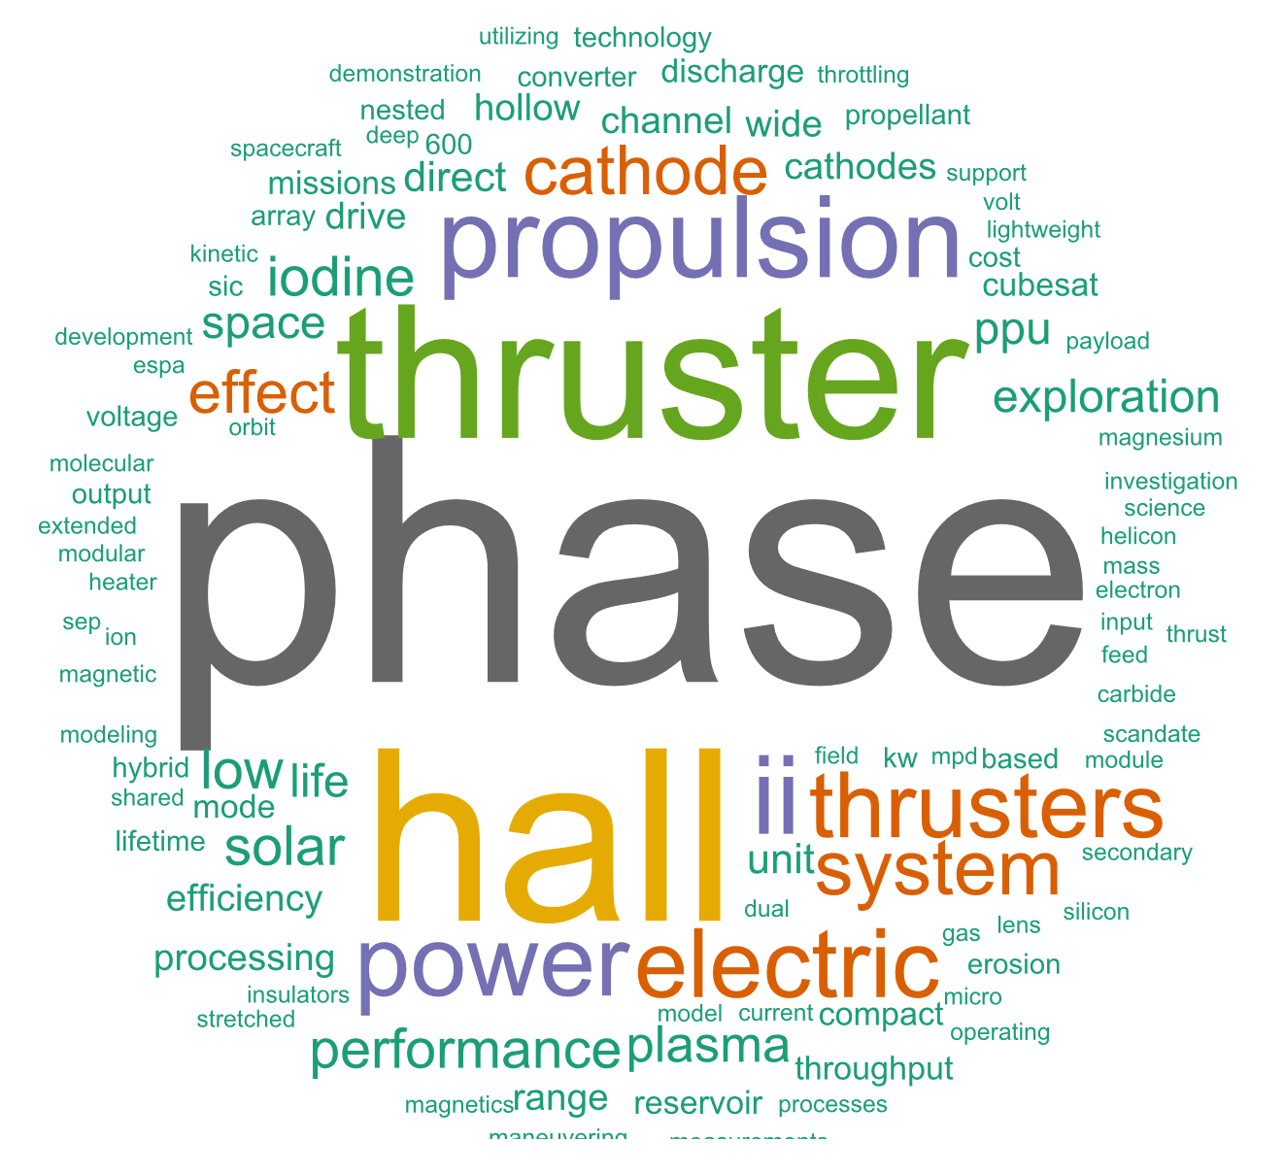
Word cloud for the title field
Notes:
Title

Slide 13
Starting Years and Months
Year
Month

Slide 14
The People Behind the Studies
Directors
Principle Investigators
Notes:
Two directors dominated the studies: Jason L Kessler (73) and Claudia M Meyer (14)
7 total program directors. One highly prolific program director
46 principal investigators, much more evenly spread with only one outlier at 11 studies (220% more than next person)

Slide 15

Thoughts?

